Slide 1
Predicting Customer Churn

Slide 2




Group Members
Aditya Bansal
Yijing Huang
Riley Ma
Palak Nath
MSBA
MSA
MSA
MSBA

Slide 3
Contents
01. Introduction
Business Problem
Existing theory
Data analytics Problem & Theory
02. Data Description
EDA
TABLEAU
03. Statistical Model Building
04. Result Interpretation
Interpretation
Predication

Slide 4
Introduction

Slide 5
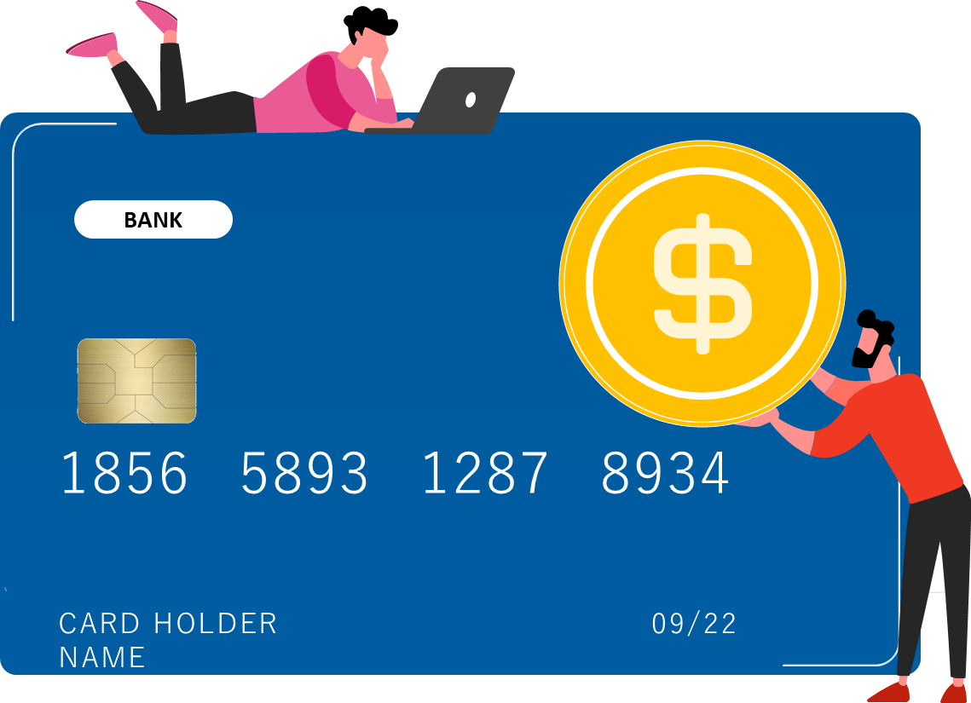
What is Churning ?
Opening credit cards just to receive welcome bonuses or other perks is known as credit card churning. Closing cards usually entails doing so after the bonus posts to your account and before the subsequent yearly fee is assessed.
For card issuers, a trend of fast opening and closing cards is frequently cause for concern.
Notes:
Opening credit cards just to receive welcome bonuses or other perks is known as credit card churning. Closing cards usually entails doing so after the bonus posts to your account and before the subsequent yearly fee is assessed. For card issuers, a trend of fast opening and closing cards is frequently cause for concern.

Slide 6

How to Keep Our Customer
Be Monopolist
Competition amongst credit card companies to be the monopolist
Retaining Customers
Companies provide Cashbacks, bonuses, no fees & other attractive schemes to retain customers
Why Churning?
People see attractive joining bonuses in other companies so they churn
The Covid Effect
People in post-COVID period concerned more about their finance
1.1 Description of problem

Slide 7

1.1 Description of problem
Banks want to figure out the factors that make customer leave credit card service.
Foresee the leaving in advanced.
Improve their service to influence customers’ decisions and solve the problem.
What are the factors affecting the churning of customers in credit card services?

Slide 8
1.2 Result Intuition
Factors that contribute OR are related to the churning of customers:
Credit Limit
Card Utilization
Low Credit Limit on the credit card.
Low Average Card Utilization Ratio.
High P(churning)
Months on Book
Open to Buy Credit Line
Less period of relationship with the bank.
High open to buy Credit Line (For the last 12 months)
Number of Products
Low number of products held by the customer.

Slide 9
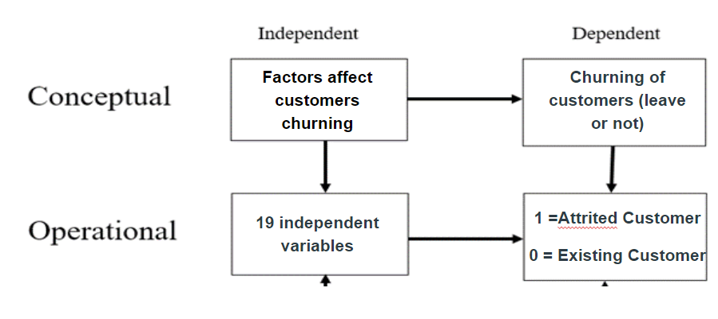
1.3 Data analytics Problem & Theory

Slide 10
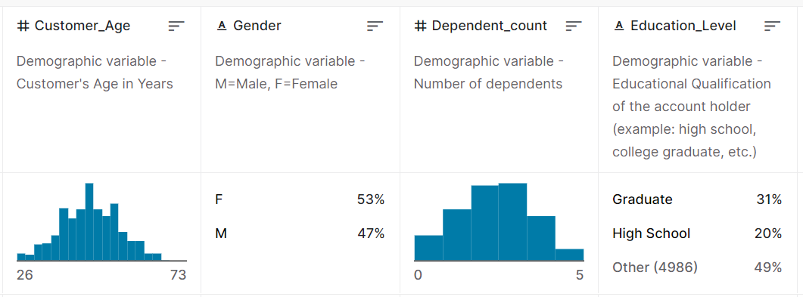
1.3 Data analytics Problem & Theory
Intro of 19 independent variables

Slide 11
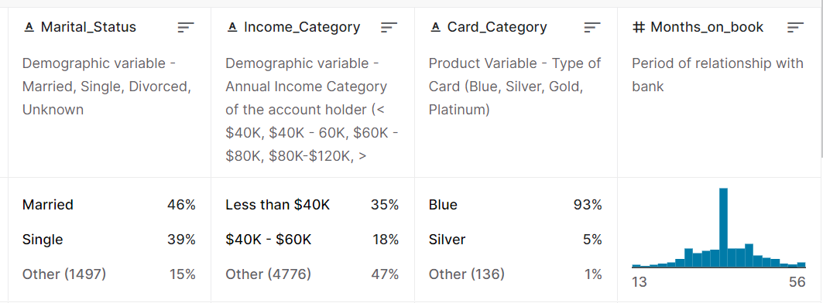
1.3 Data analytics Problem & Theory
Intro of 19 independent variables

Slide 12
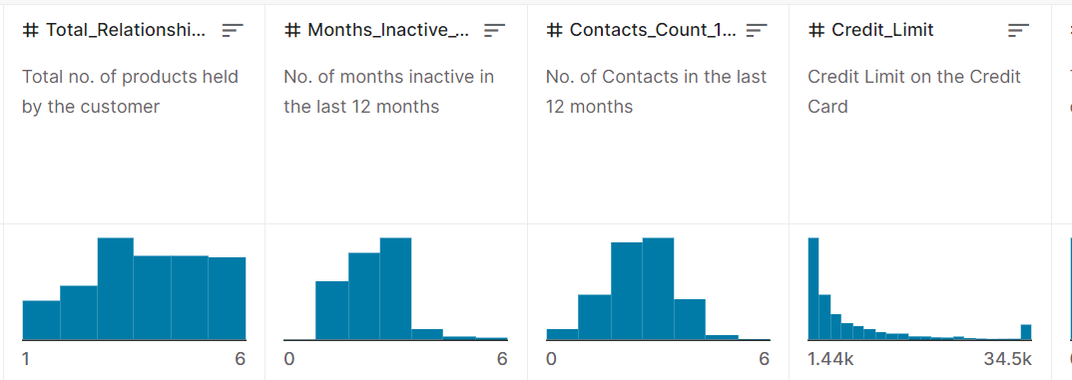
1.3 Data analytics Problem & Theory
Intro of 19 independent variables

Slide 13
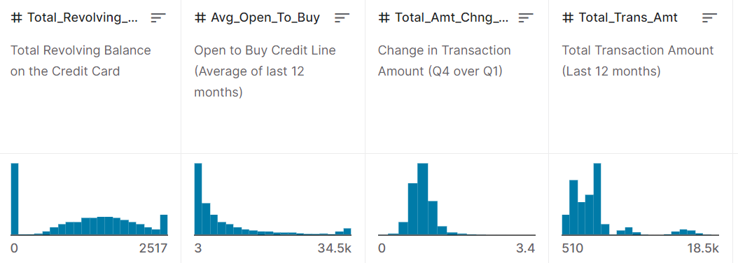
1.3 Data analytics Problem & Theory
Intro of 19 independent variables

Slide 14
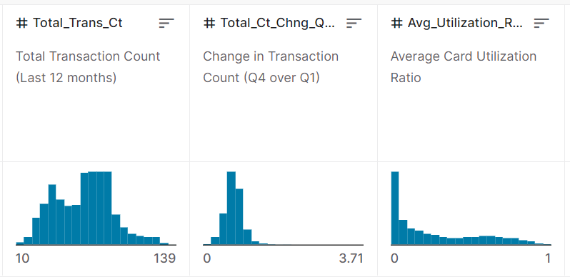
1.3 Data analytics Problem & Theory
Intro of 19 independent variables

Slide 15
1.3 Data analytics Problem & Theory
Heatmap
Logistic regression
01.
Showing correlation amongst variables and drop off the highly correlated variables
03.
Find the relationship between 19 independent variables and churning or stay
02.
EDA
Exploratory Data Analysis is used by data scientists to analyze and investigate data sets and summarize their main characteristics, often employing data visualization methods.

Slide 16
Data Description
02

Slide 17
Description of the Data
10k Rows and 21 Columns
18 Features
Source: Kaggle.com
Size: 1.51 MB
DV:Attrition_Flag
Sector: Banking/Marketing
Data Link: https://www.kaggle.com/datasets/sakshigoyal7/credit-card-customers

Slide 18
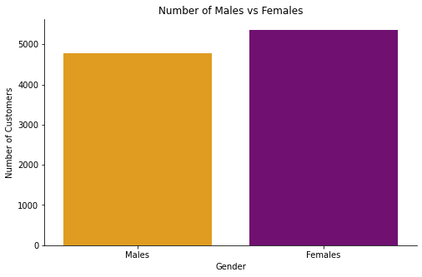
Exploratory Data Analysis

Slide 19
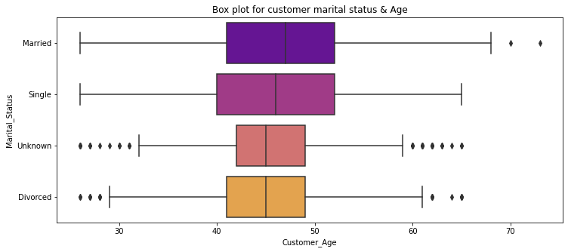
Exploratory Data Analysis

Slide 20
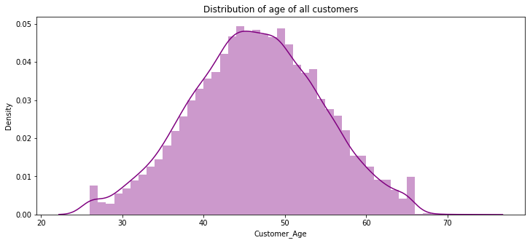
Exploratory Data Analysis

Slide 21
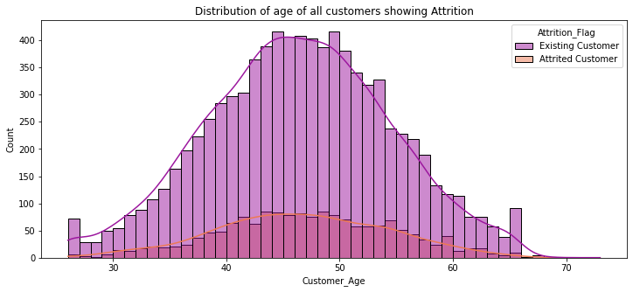
Exploratory Data Analysis

Slide 22
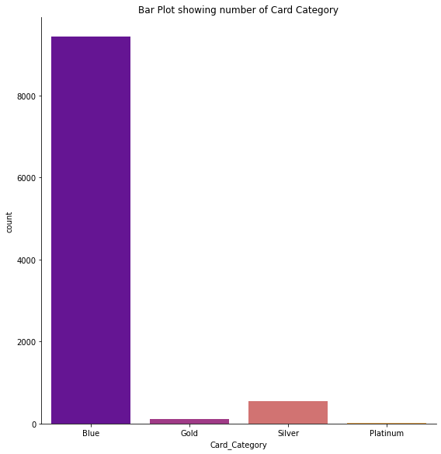
Exploratory Data Analysis
There are 4 Card Categories:
Blue
Gold
Silver
Platinum

Slide 23
Statistical
model
Building
03

Slide 24
Steps of Model Building
Step 01
Step 02
Step 03
Step 04
Data Preprocessing
Converting Categorical Columns into Numerical columns
Feature Selection
Building the Classification Model

Slide 25
Data Preprocessing
Check for Missing Data
Check for Duplicate Data
Remove Useless Columns
Naive_Bayes_Classifier_Attrition_Flag_Card_Category_Contacts_Count_12_mon_Dependent_count_Education_Level_Months_Inactive_12_mon_1
Naive_Bayes_Classifier_Attrition_Flag_Card_Category_Contacts_Count_12_mon_Dependent_count_Education_Level_Months_Inactive_12_mon_1
CLIENTNUM
Luckily, we picked a clean dataset with no missing data or no duplicate values.
For columns, we removed the 3 columns that were of no use to us.

Slide 26
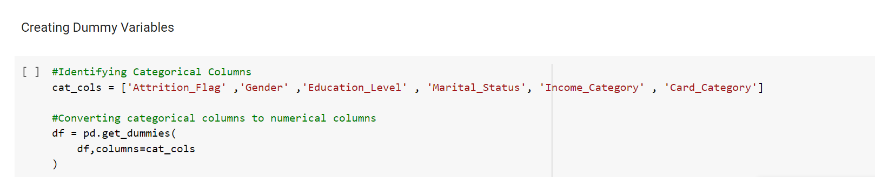
Categorical to Numerical Conversion
We had 6 categorical variables namely:
'Attrition_Flag' ,'Gender' ,'Education_Level' , 'Marital_Status', 'Income_Category' & 'Card_Category' .
To convert them into numerical type, we used the concept of Dummy Variables.

Slide 27
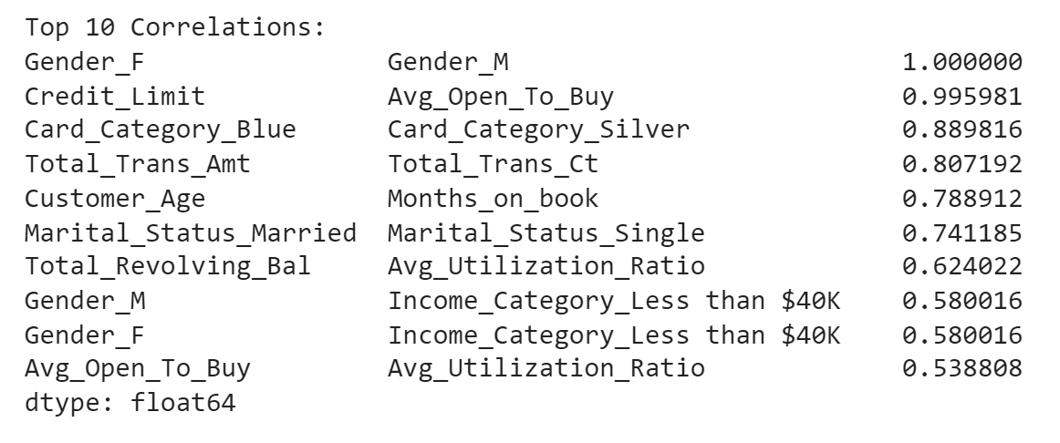
Feature selection
For selecting features we used the concept of correlation, we found out the top 10 highly correlated variables and removed one out of the pair of variables that had a correlation of more than 0.9.
Dropped
'Gender_M' & 'Avg_Open_To_Buy'

Slide 28
Description of the Data Analytics Model
For our project we had to classify whether a customer will churn or no. To do the classification, we used Logistic Regression model from the SkLearn library in Python.
To do so we divided the into training and testing data and started building the model.
To do so, we first tried building the model using all variables and got an accuracy of :
Logistic Regression Accuracy Results:
Training Model accuracy: 88.87%
Test Model accuracy: 90.52% Then, removed the two highly correlated features and ran the model again there was a significant improvement in the accuracy and model prediction.

Slide 29
Result
Interpretation
04

Slide 30
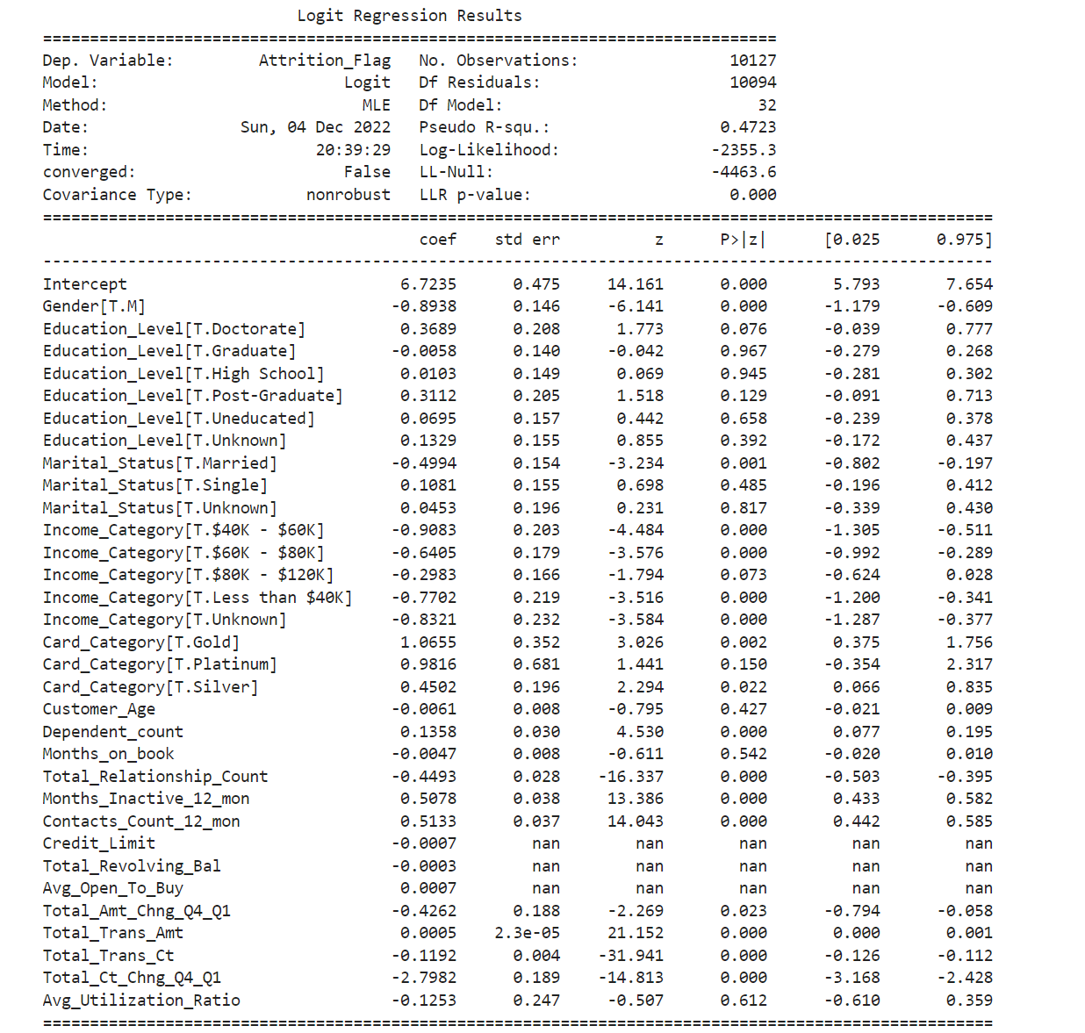
Feature
Coefficient
Male 0.89 less
likely to churn
than female
Conclusion:
Positively related to churning
Months_Inactive_12_mon
Contacts Count 12 mon
Negatively related to churning
Total_Ct_chng_Q4_Q1
Insignificant relation:
Credit limit
Avg_open_To_buy
Average Card Utilization Ratio
Months on book

Slide 31
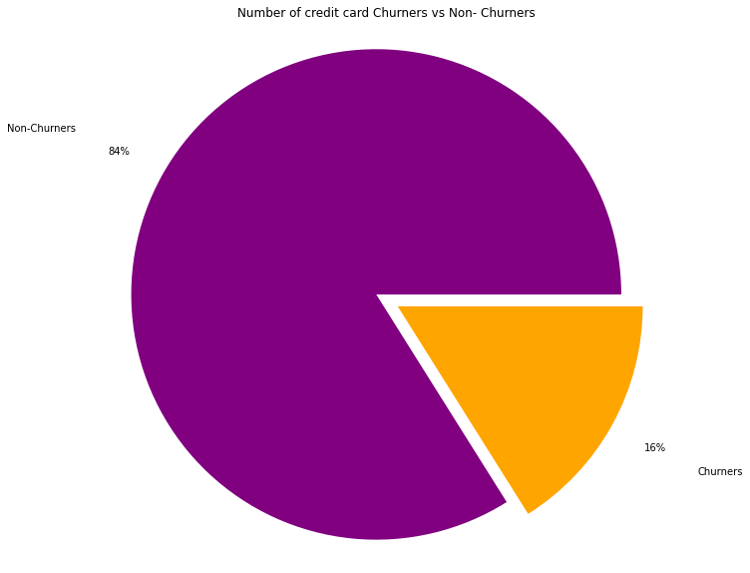
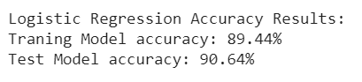
Accuracy of the Model Prediction
Our model was able to predict the customers who would churn with an accuracy of 90.64%
Predicting that approx 16% of the customers would churn or leave the credit card service.

Slide 32
Thank You!
We are open to Questions/Comments.

